Slide 1
Module 7: Course Wrap-up
AWS Academy Machine Learning Foundations
© 2020, Amazon Web Services, Inc. or its Affiliates. All rights reserved.
Notes:
Welcome to Module 7: Course Wrap-up

Slide 2

Module overview
Sections
Course summary
AWS Documentation
Certifications and resources
Notes:
Congratulations on completing the AWS Academy Machine Learning course! You will now take a few minutes to review what you learned, and where to go from here.

Slide 3
Section 1: Course summary
Module 7: Course Wrap-up
Notes:
This summary explains the topics that were covered in the course.

Slide 4

Course summary
You should now be able to:
Describe machine learning
Implement a machine learning pipeline by using Amazon SageMaker
Use managed Amazon ML services for forecasting, computer vision, and natural language processing
Notes:
In this course, you learned how to describe machine learning. This included learning how to:
Recognize how machine learning and deep learning are part of artificial intelligence
Describe artificial intelligence and machine learning terminology
Identify how machine learning can be used to solve a business problem
Describe the machine learning process
List the tools available to data scientists
Identify when to use machine learning instead of traditional software development methods
You also learned how to implement a machine learning pipeline. This included how to:
Formulate a problem from a business request
Obtain and secure data for machine learning
Build a Jupyter notebook by using Amazon SageMaker
Outline the process for evaluating data
Explain why data needs to be preprocessed
Use open-source tools to examine and preprocess data
Use Amazon SageMaker to train and host a machine learning model
Use cross validation to test the performance of an ML model
Use a hosted model for inference
Create an Amazon SageMaker hyperparameter tuning job to optimize a model’s effectiveness
Finally, you learned how to use managed Amazon ML services for forecasting, computer vision, and natural language processing. You are now able to:
Describe the business problems that Amazon Forecast solves
Describe the challenges of working with time series data
List the steps that are required to forecast by using Amazon Forecast
Use Amazon Forecast to make a prediction
Describe the computer vision use cases
Describe the managed Amazon ML services for image and video analysis
List the steps that are required to prepare a custom dataset for object detection
Describe how Amazon SageMaker Ground Truth can be used to prepare a custom dataset
Use Amazon Rekognition to perform facial detection
Describe the natural language processing (NLP) use cases that are solved by using managed Amazon ML services
Describe the managed Amazon ML services available for NLP

Slide 5
Section 2: AWS Documentation
Module 7: Course Wrap-up
Notes:
You will now review the AWS Documentation and common frameworks that represent best practices for implementing solutions with AWS.

Slide 6
AWS Documentation
Find user guides, developer guides, API references, tutorials, and more
AWS Documentation
Whitepapers are also available at AWS Whitepapers including the following list, which contains recommended reading for the AWS Cloud Practitioner exam –
Overview of Amazon Web Services
Architecting for the Cloud: AWS Best Practices
How AWS Pricing Works
The Total Cost of (Non) Ownership of Web Applications in the Cloud
Notes:
AWS provides extensive and detailed documentation for each AWS service. Guides and API references are organized by service category. Also, many general resources and tutorials can be accessed from the AWS Documentation pages. General resources include case studies, an A-to-Z glossary of AWS terms, whitepapers, FAQs, information about AWS Training and Certification, and more.
Also, each SDK and toolkit has documentation, such as the AWS Command Line Interface (AWS CLI), the boto3 libraries for AWS SDK for Python, and many others.
AWS whitepapers and guides can be filtered by product, category, or industry, so you can find the information that is most relevant to your needs.

Slide 7
Section 3: AWS Certified Machine Learning – Specialty
Module 7: Course Wrap-up
Notes:
Although this course is not designed to prepare you to achieve the AWS Certified Machine Learning – Specialty, you can continue to work towards certification. The next few slides review how you can achieve that goal.

Slide 8
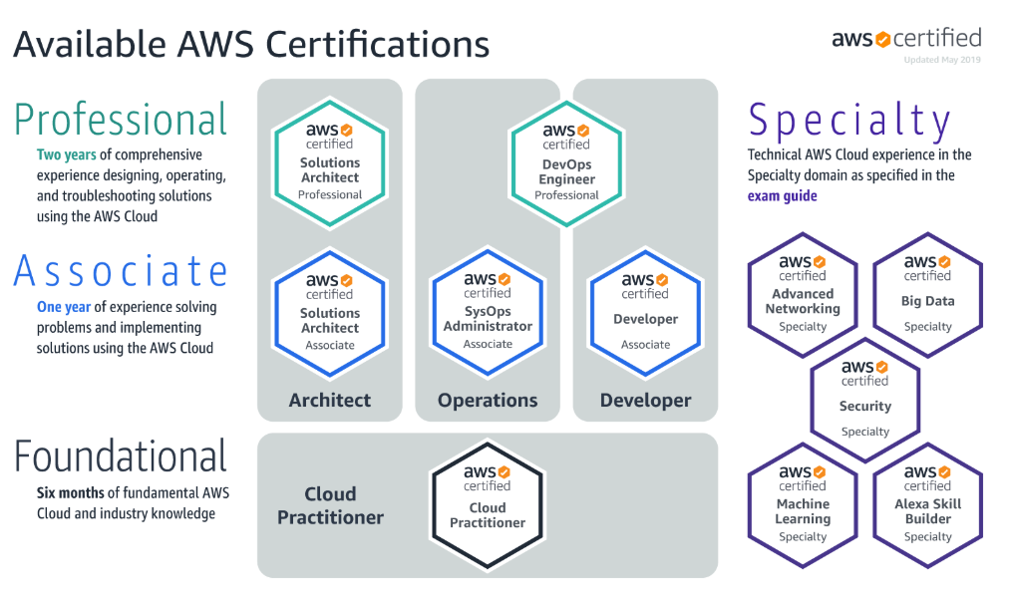
AWS certification exams
AWS Certification
Notes:
AWS Certification helps learners build credibility and confidence by validating their cloud expertise with an industry-recognized credential. It also helps organizations identify skilled professionals who can lead cloud initiatives by using AWS.
You must earn a passing score by taking a proctored exam to earn an AWS certification. After receiving a passing score, you will receive your certification credentials.
AWS Certification does not publish a list of all services or features that are covered in a certification exam. However, the exam guide for each exam lists the current topic areas and objectives that are covered in the exam. You can find exam guides on the Prepare for Your AWS Certification Exam webpage.
You will be required to update your certification (or recertify) every 3 years. View the AWS Certification Recertification page for more details.
The information on this slide is current as of June 2020. However, exams are frequently updated. Also, the details regarding which exams are available—and what is tested by each exam—are subject to change.
For the newest AWS certification exam information, go to AWS Certification.

Slide 9

Certification capabilities
Certification validates the following abilities:
Select and justify the appropriate machine learning approach for a given business problem
Identify appropriate AWS services to implement machine learning solutions
Design and implement scalable, cost-optimized, reliable, and secure machine learning solutions
Notes:
The AWS Certified Machine Learning – Specialty means that you can select and justify the appropriate machine learning approach for a given business problem. You can also identify appropriate AWS services to implement machine learning solutions. Finally, you can design and implement scalable, cost-optimized, reliable, and secure machine learning solutions.

Slide 10
Certification requirements
Recommended knowledge and experience:
1–2 years of experience developing, architecting, or running ML and deep learning workloads on the AWS Cloud
The ability to express the intuition behind basic ML algorithms
Experience in performing basic hyperparameter optimization
Experience with ML and deep learning frameworks
The ability to follow model-training best practices
The ability to follow deployment and operational best practices
Notes:
Before you take the AWS Certified Machine Learning – Specialty exam, we recommend that you have the following knowledge and experience.
First, you should have 1–2 years of experience in developing, architecting, or running ML and deep learning workloads on the AWS Cloud. Your experience should include performing basic hyperparameter optimization and working with machine learning and deep learning frameworks. You should also be able to express the intuition behind basic ML algorithms. Finally, you should be able to follow model-training best practices along with deployment and operational best practices.

Slide 11
Thank you
Notes:
Thank you for completing this module.

